Slide 1
Intervention Designs in Real World Settings
Amy Amspoker
Hao Duong

Slide 2
Introduction
Notes:
Hao and I were fortunate to be able to take a course on Intervention Designs in Real World Settings through UCSF in the Spring.
We would like to give you a very broad overview of what we learned and then gage if there are particular areas/designs you would like to dig deeper into in subsequent sessions.

Slide 3
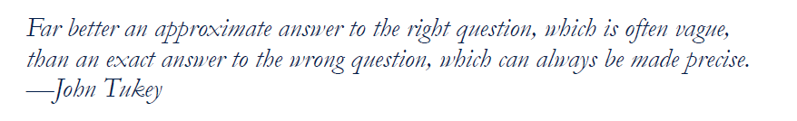
Why a course on real-world intervention designs?
There is an evidence-practice gap in how we produce ‘actionable’ evidence (which we can partially fix with better designs suited to our questions)
We often use the same tool for all questions, when there are many tools for different questions
Notes:
What is the impetus of this course?
There is an evidence-practice gap in how we produce actionable evidence:
Healthcare is complex and expensive and there is a big demand for evidence to inform decisions that lead to improved, efficient, and affordable care.
Care providers, researchers, administrators, payers, regulators, and the public agree that the provision of clinical care and related public health and social
services, should be informed by high-quality scientific evidence regarding the risks and benefits of treatments, interventions, and programs…..
But we do not always produce the evidence needed for real world decision making.
Most of our highest quality evidence is generated in a ‘vacuum’.
> Although randomized controlled trials (RCTs) provide efficacy data on whether an intervention works in ideal circumstances, the reality is that they often do not inform clinical decisions.
2. We often use the same tool for all questions, when there are many tools for different questions.
> For much of modern medical history, there has been the assumption that clinical research should be kept apart from routine patient care to allow that
research to answer our Qs.
> As a result, we now have an investigative system in which research data have been collected using mostly stand-alone data collection systems, designed to
ensure that the information gathered during research activities is valid and complete.
> However, it is understood that having separate systems for research and care comes at a significant cost, in terms of time to conduct research, costs of
research and in terms of relevance to “real-world” situations.
> Also, as we have more opportunity for embedded data collection systems to replace or augment stand-alone data collection, our choices of designs to
study interventions has expanded, and we now have many kinds of intervention studies
> This course presented different designs that address a range of intervention questions so that the ‘best’ tool for the question can be used.
Important questions should not be ignored if they are unable to fit into an RCT. Rather, the strongest possible design that can feasibly
be implemented should be chosen.
Whatever design is chosen, careful attention must be given to the viability of the assumptions of the design, adding design and analysis features to address
plausible threats to validity. This course helped us think through design and analysis features to include.
See attached handout(?) on real world intervention designs to consider – these designs were reviewed in this course and we will go over a few of them very briefly right now.

Slide 4
Pre-post studies Interrupted time series

Slide 5
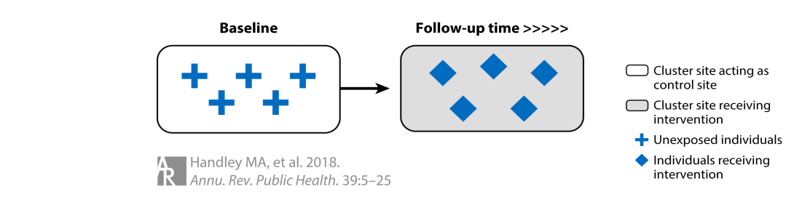
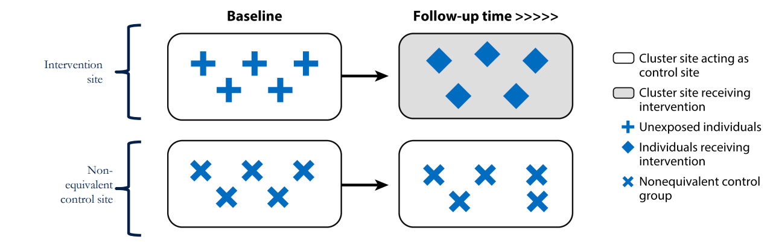
Notes:
We know about the pre-post intervention design (above) and its weaknesses.
To improve upon this, incorporating a non-equivalent group (below) is a valuable next step.
--
Eligible individuals for the intervention as exposed and a separate population as unexposed are assessed at baseline and follow-up. Samples from both populations can include the same individuals (cohort) or different individuals (cross-section) at each time point.
--
Although these groups are not randomized and bias cannot be entirely ruled out, this approach is often better than no control at all.

Slide 6
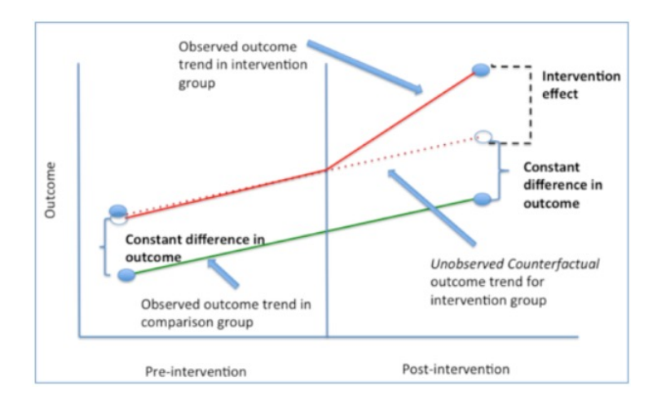
Notes:
In this figure, the non-intervention group is represented by the green line, while the intervention group is shown as the red line.
Without intervention, the red group's trajectory is expected to follow the dotted line, remaining parallel to the green line.
Any deviation from the dotted line (straight line) would indicate an effect from the intervention.
This design assumes that there are no group-specific trends that could influence the outcome independently of the intervention.
--
This design can still yield meaningful findings, especially in some research topics (unethical/unacceptable) or study settings (unfeasible) where randomization is not possible. However, it's crucial to account for these limitations in the study population selection (minimize selection bias), data collection (minimize information bias), and analysis to maximize the validity of the results.

Slide 7
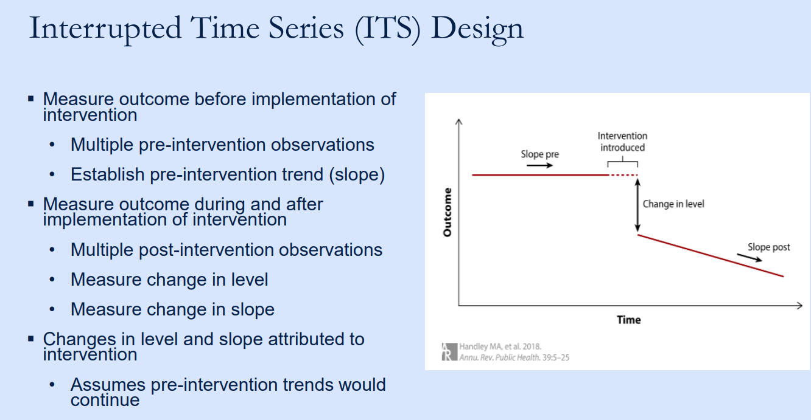
Notes:
ITS is another approach to improving pre-post intervention design.
It measures outcomes before, during, and after the intervention.
The key difference is that ITS captures multiple time points before and after the intervention, allowing it to establish a pre-intervention trend.
Any deviation from this trend (slope) after the intervention is considered a change attributable to the intervention.

Slide 8
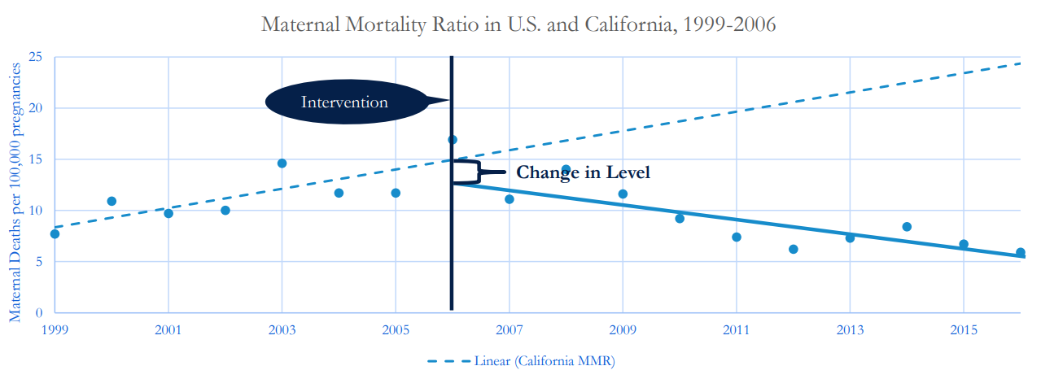
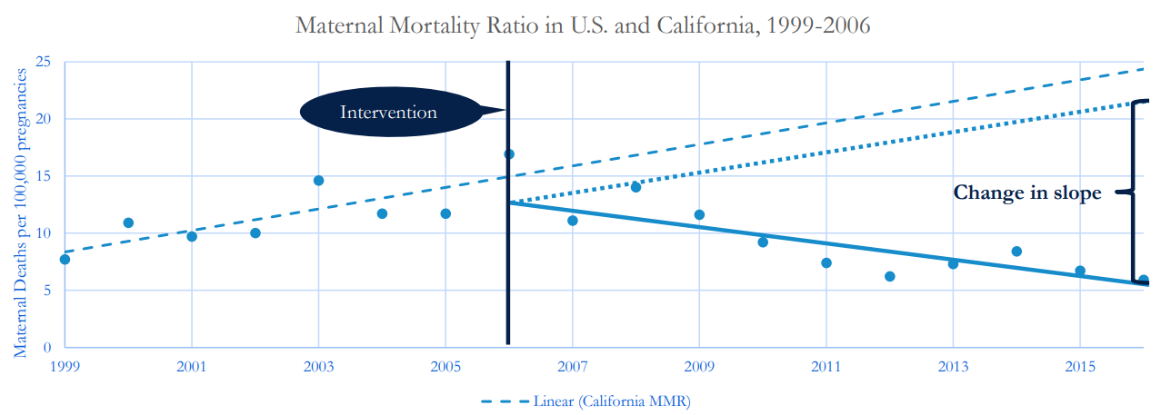
Notes:
Here is a figure illustrating a change in level immediately after the intervention, followed by a change in trend or slope.

Slide 9
Cluster Trials & Stepped-Wedge Designs

Slide 10
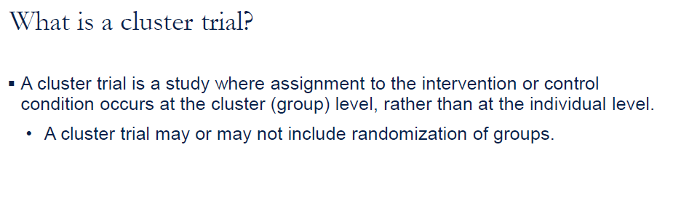
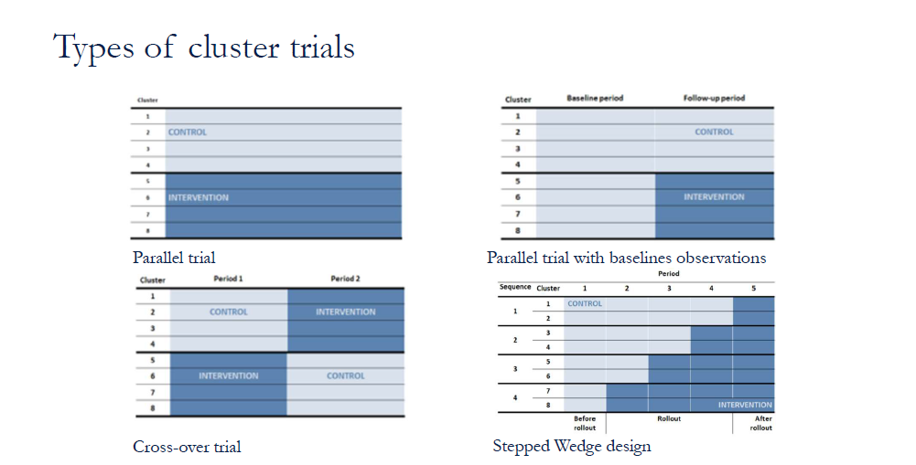
Notes:
I will say some (but not all of this), and then move into the specific type of cluster trial : Stepped Wedge Design
Why do a cluster trial?
> Intervention naturally applied at the cluster level
• Administrative convenience
• Cooperation of implementers
• Enhance participant participation
> Avoid contamination
• No overlap between intervention and control settings
Why NOT do a cluster trial?
> Larger sample size required, sometimes MUCH larger
• Difficult to know how much larger
> Randomization may not eliminate confounding
• If number of clusters is small, then balance unlikely
> Blinding
• Difficult to blind implementers
> Analysis may be more complex
• If outcomes assessed at the individual-level, clustering and imbalance must be
taken into account in analysis
Why randomize clusters?
> increases internal validity, reduces confounding, selection bias, and increases fidelity
> Randomization more likely to balance providers and participants on measured and unmeasured factors (internal validity)
> Pre-trial level and trend in outcomes (temporal trends)
Provider and patient characteristics at baseline (confounding)
> Motivation to participate in the trial (selection bias)
> Motivation to implement / participate in the intervention (fidelity)
:>Motivation to remain in the trial (differential loss-to follow-up)

Slide 11
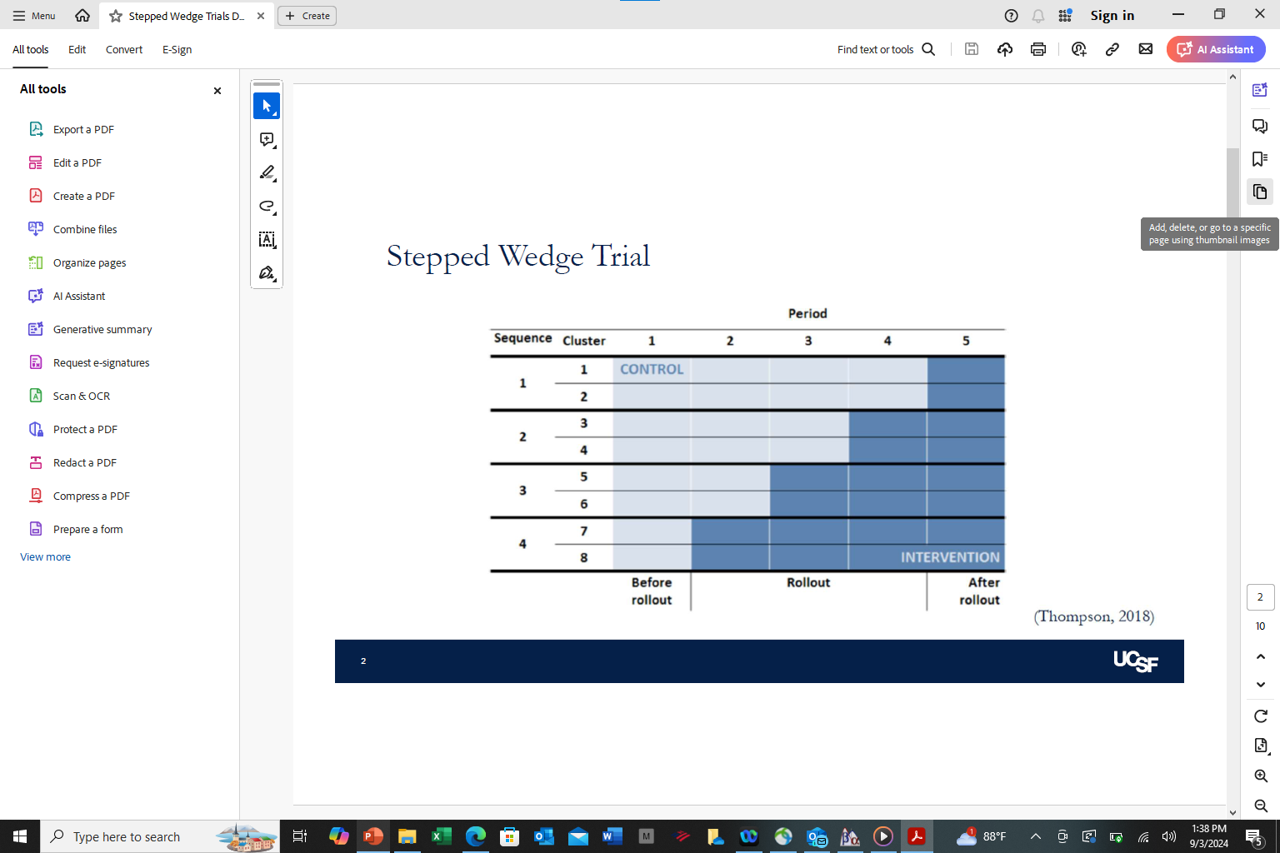
Stepped Wedge Trial
Notes:
Details
• A ‘roll-out’ design where the intervention is placed into a setting at a specific time
• Intervention is rolled out over time, usually at the site level, and the groups not yet receiving the intervention provide control data for the relevant time periods
• Participants/sites who initially do not receive the intervention later crossover to receive the Intervention
Cross-over trial
• Time of crossover assigned
• Crossover is unidirectional
• Sample
• Not as sensitive to correlation within clusters (pre-post within clusters)
• At each time point, individuals may be same (cohort) or different (cross sectional)
Measurement
• Outcomes measured at each step
• May result in MANY more total observations
▪ Analysis
• Similar to other Cluster Trials
‒ Must account for calendar time

Slide 12
Stepped-Wedge Trials
Efficient
Groups act as their own control so fewer needed
Logistical or financial benefits
Cannot introduce intervention in all groups at once
Can study the effect of time on intervention effectiveness (i.e., seasonality, time since introduction)
Can examine heterogeneity of effects of intervention
Over time
Across strata/waves
Across clusters
Often takes longer to implement
More measurement required (can be difficult/costly/timely)
Site differences and implementation processes can vary over time
Risk of contamination in later sites or intervention fatigue
Sites may not be willing/able to implement when assigned (jeopardizing internal validity)
Notes:
Stepped Wedge Trials:
Advantages:
> Everyone/all sites get the intervention, which is appealing for perceived equity/fairness
>Those who wait provide control data during the time when others receive the intervention
> Investigators do not need to supply the intervention in all sites in a short timeframe, known as staggered implementation (also possible with Cluster Trials)
However, there are important Disadvantages
Often takes longer than other designs to implement
Control data must be collected or ascertained from sites or participants=more measurement required
Site differences and implementation processes can vary significantly overtime
Risk of contamination in later sites or intervention fatigue—both can washout potential intervention effects
Sites may not be willing/able to implement when assigned, thereby potentially jeopardizing internal validity.
GEE or mixed models, both accounting for clustering of observations within a group and secular trends (calendar time)
> GEE enables us to understand the average effect across the population , whereas Mixed Effects models enable us to explore the response of individual participants (and take into account random effects)
SWD are attractive, but very difficult to do right.

Slide 13
MOST The multiphase optimization strategy

Slide 14
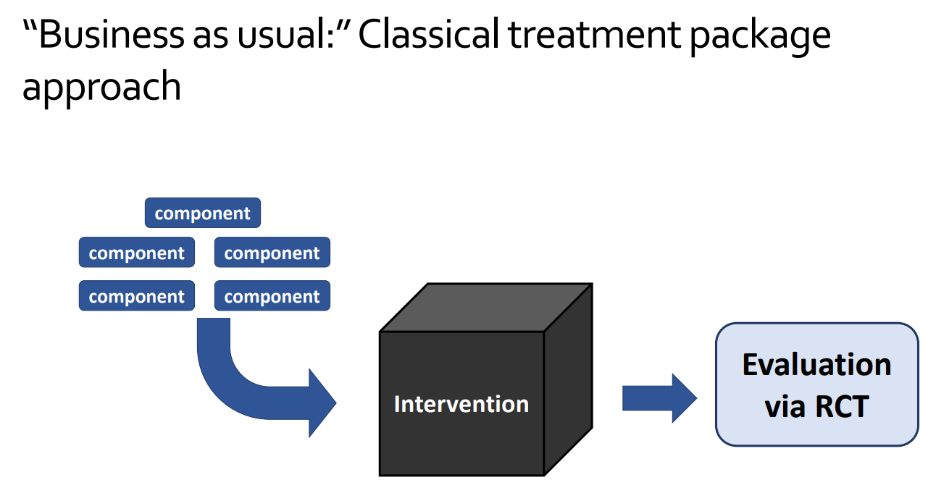
Notes:
Traditionally, intervention packages are developed and tested through randomized trials, often with limited prior information.
A successful or failed outcome doesn't reveal
which components were responsible, and
whether including more components significantly improves the outcome (cost-effectiveness).

Slide 15
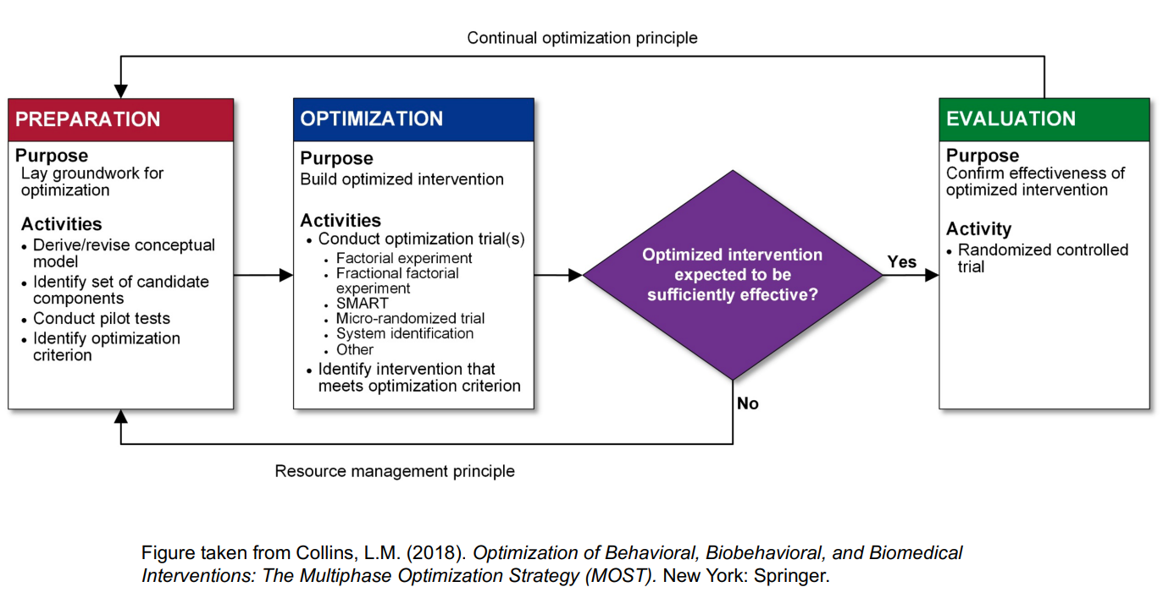
Notes:
MOST is the multiphase optimization strategy.
It includes three phases, with a key difference in Phase 2-the optimization phase.
This phase aims to determine:
Which implementation strategies are most cost-effective
What is the most effective set of components, given implementation budget or constraints?
Which components should be deleted to make the intervention more cost-effective?
--
There are multiple ways (trials) to optimize. I will go briefly two common ones in the next two slides.

Slide 16
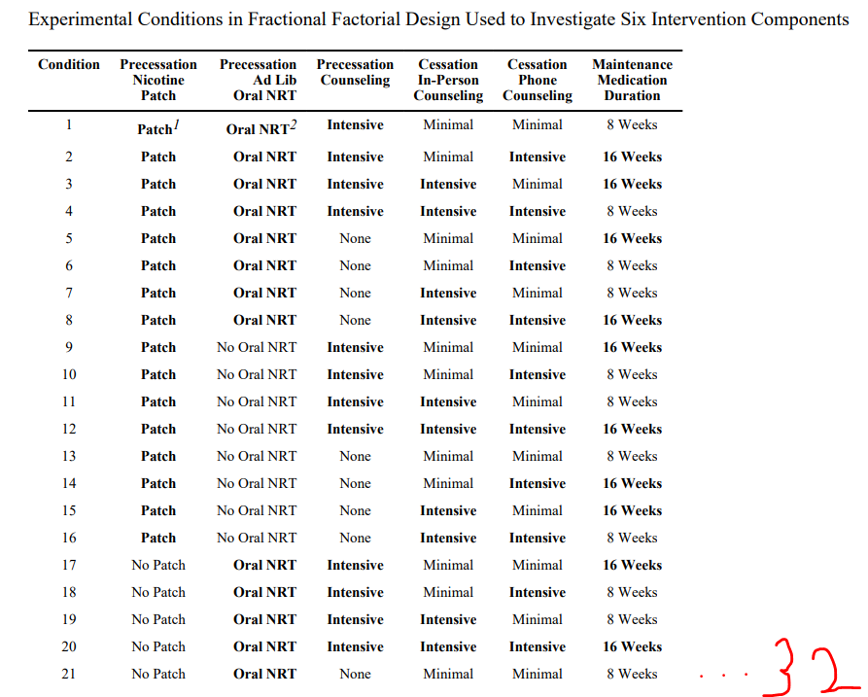
Factorial experiment/Fractional factorial experiment design
Notes:
A factorial experiment is an experimental design where the effects of two or more factors (intervention components) are examined simultaneously. This design allows for the evaluation of both the individual effects of each factor and their combined impact on the outcome.
--
Here is a study using fractional factorial experiment design to assess the effectiveness of 6 smoking cessation interventions, aiming to answer the following questions:
Which of the five interventions are significantly associated with increased self-efficacy to quit smoking?
Which set of interventions should be recommended?

Slide 17
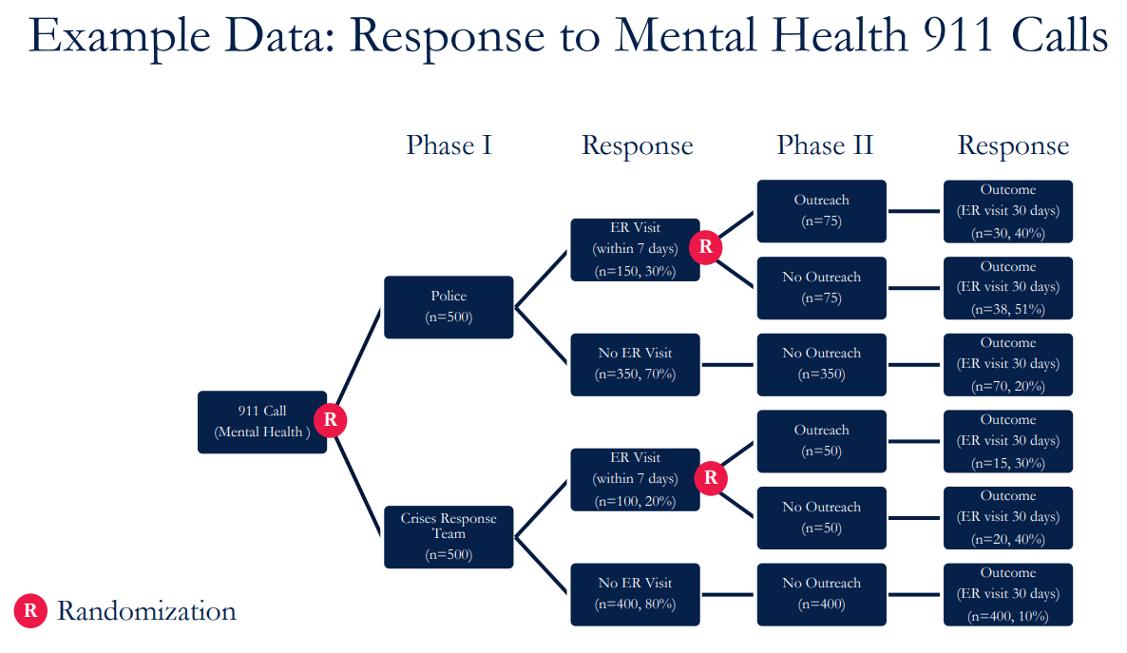
SMART design
Notes:
SMART design is another commonly used approach to optimize study interventions.
Here is an example from the lecture about responses to mental health 911 calls.
There are two phases of response, with the second one depending on the outcome of the first.
--
When patients called 911, they were randomized to either [a police visit] or [a crisis response team visit].
Among these patients, some visited the ER within 7 days while others did not.
Those who did not visit the ER received no outreach.
Those who visited the ER were further randomized to receive either outreach or no outreach.
All participants were evaluated based on their ER visit within 30 days.
--
This kind of study design allows to answer questions:
What is best initial response to mental health 911 calls? Police vs CRT?
What is the best response for individuals who have ER visits within 7 days? Outreach vs no outreach?
What is the best strategy in response to mental health 911 calls?
Compare 4 strategies: (a) Police, (b) Police + outreach, (c) CRT, (d) CRT + outreach

Slide 18
Choice / Preference Designs
Notes:
Preference designs are an alternative clinical trial design that can be used to evaluate how patient preferences for a certain treatment may influence an outcome.
There are two general approaches to preference designs:
1. Partially randomized patient preference intervention trial, with a preference arm at outset- T0 (partially randomized patient preference trials)
2. Two-stage patient preference intervention trial, with randomized preference arm at T1

Slide 19
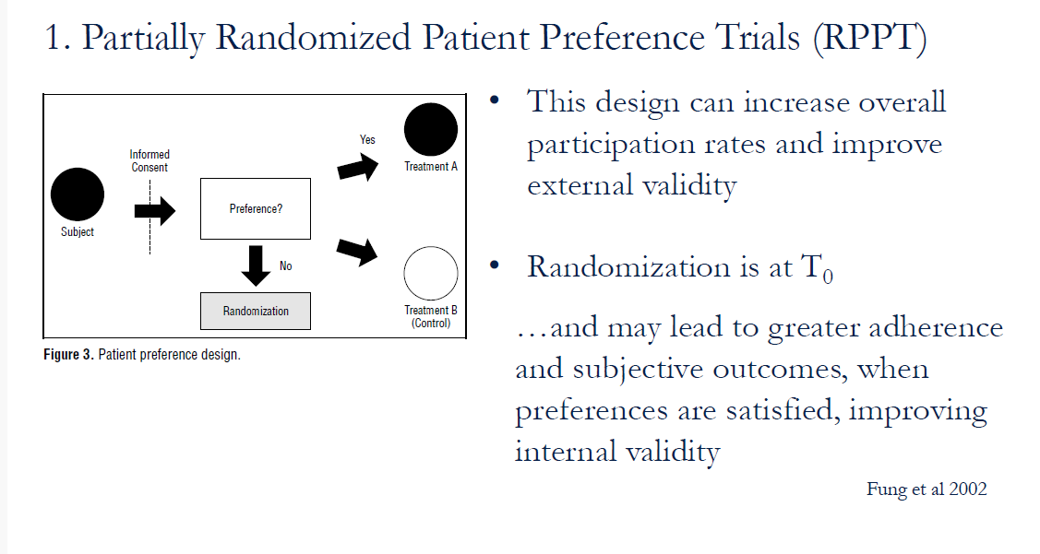
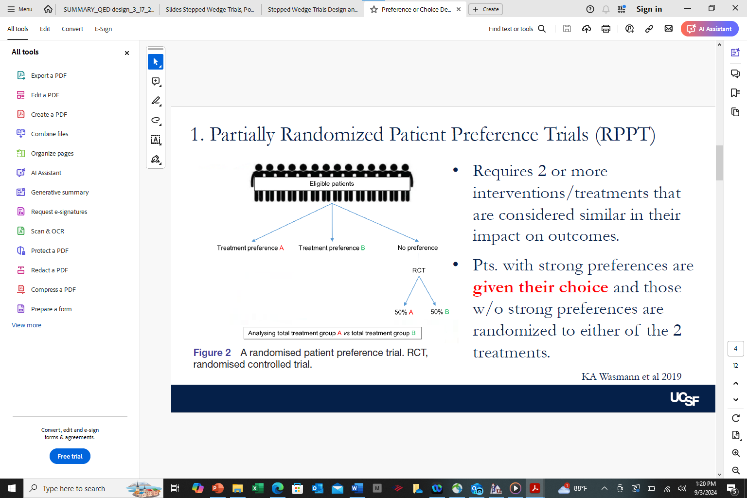
Notes:
Two figures of the same design = a partially randomized patient preference trial.
>Requires 2 or more interventions/treatments that are considered similar in their impact on outcomes.
>Pts. with strong preferences are given their choice and those w/o strong preferences are
randomized to one of the 2 treatments.
>This design can increase overall participation rates and improve external validity
>Randomization is at T0
…and may lead to greater adherence and subjective outcomes, when preferences are satisfied, improving internal validity

Slide 20
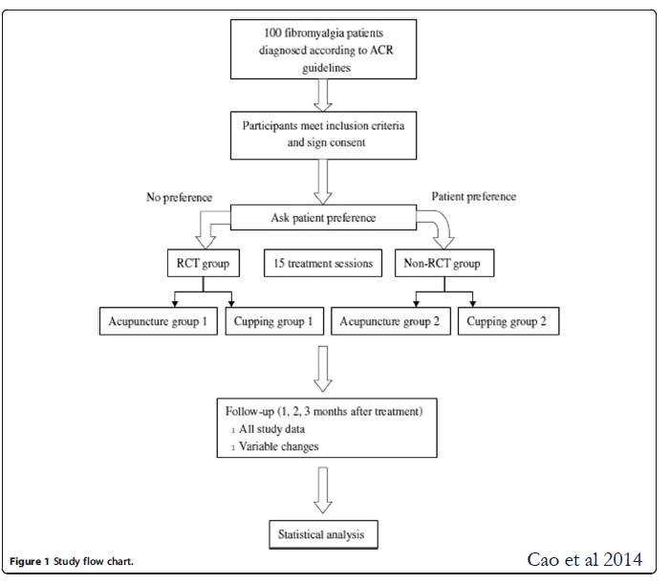
Notes:
An Example of an RPPT

Slide 21
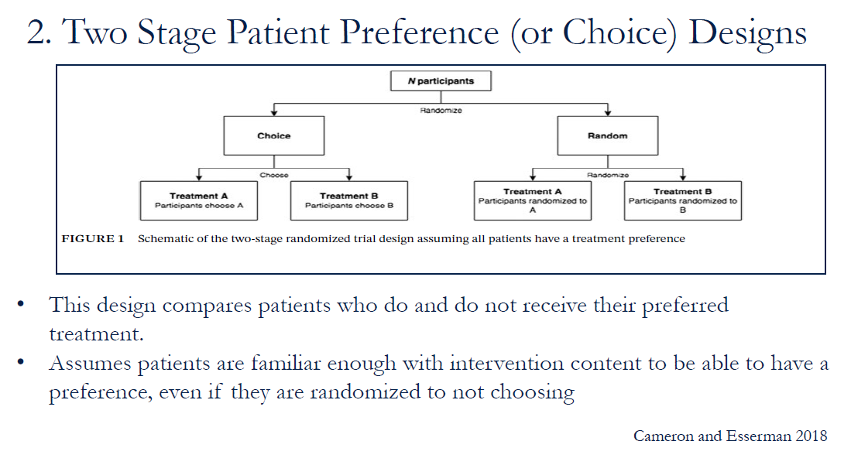
Notes:
This design is fully randomized and compares patients who do and do not receive their preferred treatment.
These are the types of questions we can ask with a two-stage patient preference design:
• Is there a selection effect? In other words, is the effect of one selected treatment better than the other selected treatment (compare choice A vs choice B)?
The selection effect refers to the effect of a patient’s selection of his or her preferred treatment.
• Is there a preference effect? In other words, compared to no choice (random), what is the effect of choice? Compare outcomes between those who choose treatment A and those who were randomized to treatment A.
The preference effect is the additional change in outcome that results from the interaction between a patient’s preferred treatment and
the treatment he/she actually receives.
Does treatment A have better outcomes than treatment B? Does the treatment effect vary based on whether the treatment was a choice?

Slide 22
Hybrid

Slide 23
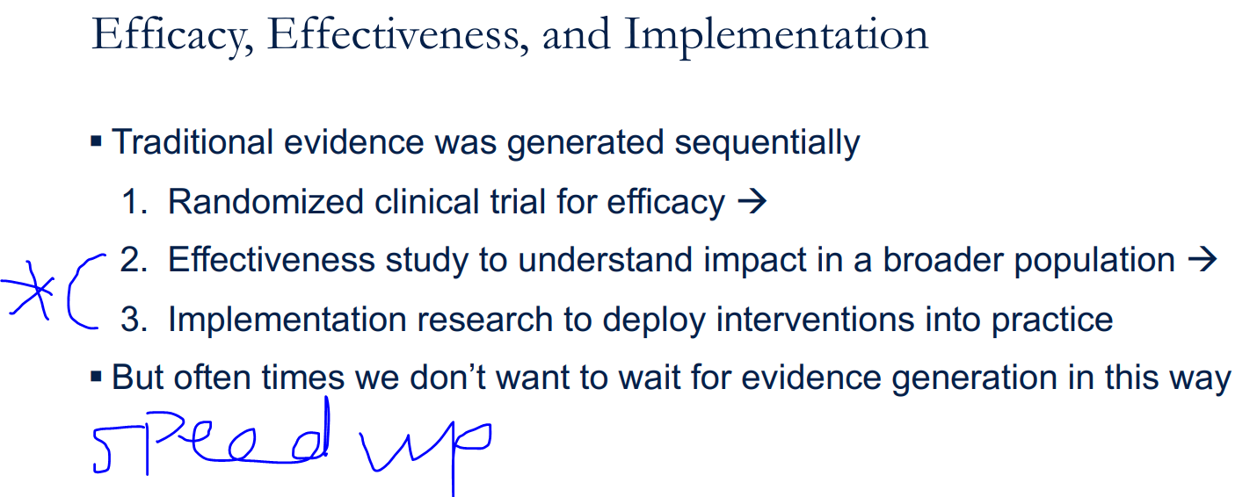
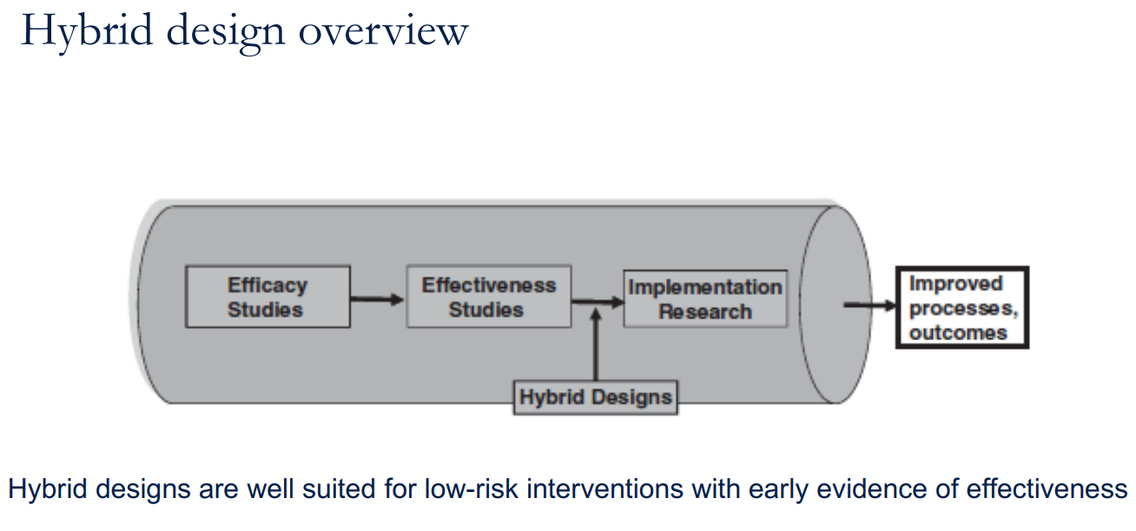
Notes:
Traditionally, studies were conducted step-by-step:
Start with a randomized clinical trial to test how well an intervention works.
Follow up with an effectiveness study to see how it performs in a larger, more diverse group.
Conduct implementation research to put the intervention into practice.
When we need faster results and do not want to wait for each step to be completed (especially steps 2 and 3), we use a hybrid design.

Slide 24
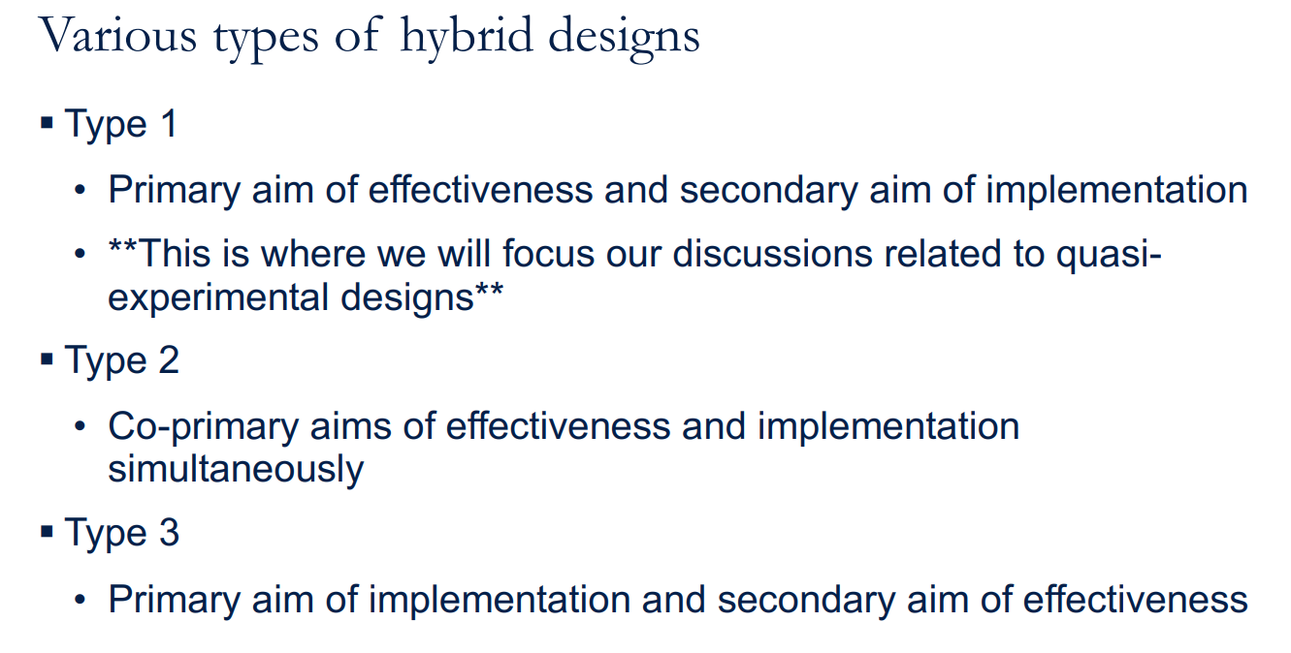
Notes:
Type 1 studies primarily focus on effectiveness, with implementation as a secondary aim.
Hybrid type 1 designs work when early evidence of effectiveness, but still unclear if effective in the new setting or population.
Type 2 studies have co-primary aims, addressing both effectiveness and implementation simultaneously.
Hybrid type 2 designs work when there is interest in studying implementation strategies, or comparing more than one strategy.
Hybrid type 2 designs also examine effectiveness –often if established evidence in other settings, but still unclear if effective in the new setting or population.
Type 3 studies prioritize implementation, with effectiveness as a secondary aim.
Hybrid type 3 designs work when the real goal is to evaluate implementation outcomes, such as fidelity, sustainability, adoption, reach, more often targeted at the system, clinic, or provider. Factors affecting maintenance and scale-up often included too.

